Slide 1

KALLAM HARANADHAREDDY INSTITUTE OF TECHNOLOGY(AUTONOMOUS)
Approved by (AICTE, New Delhi, Permanently Affiliated to JNTU KAKINADA)​ Affiliated by
NAAC with ‘A’ Grade​ NH-16, Chowdavaram, Guntur – 522019(A.P)​
Department of CSE - (AI&ML)
iForecast: Time-Series Modeling and Sales Forecasting of iPhone
Presented by
Peddinti Moria Syam 228X1A42A0
Kayasiri Neelima 228X1A42B1
Koduru Kavyasri 228X1A4268
Shaik Hassem Basha 228X1A42A9
Under the Guidance of
T. Alekhya, M. Tech (Ph. D)
Assistant Professor

Slide 2
Contents
Abstract
Literature Survey
Technical Architecture
Design & Implementation
Advantages
Conclusion

Slide 3
ABSTRACT
iForecast is a data analytics project focused on forecasting Apple iPhone sales trends in India.
The project analyzes historical sales, revenue, and market share data.
Time-series forecasting models such as ARIMA, Prophet, and LSTM are used for prediction.
Data is collected from sources like Flipkart marketplace, Apple reports, and market datasets.
Visualization dashboards are created using Tableau.
The system helps businesses understand future demand and plan strategies effectively.

Slide 4
LITERATURE SURVEY
Author / Year | Method Used | Description | Result
Smith et al., 2019 | ARIMA Model | Used ARIMA for forecasting smartphone sales using historical time-series data. | Achieved reliable short-term predictions.
Johnson & Lee, 2020 | Prophet Model | Applied Facebook Prophet for market demand prediction. | Improved forecasting accuracy for seasonal data.
Kumar et al., 2021 | LSTM Neural Networks | Used deep learning for complex sales prediction patterns. | Captured long-term dependencies effectively.
Chen et al., 2022 | Hybrid Forecasting | Combined statistical and machine learning models. | Reduced prediction error compared to single models.

Slide 5
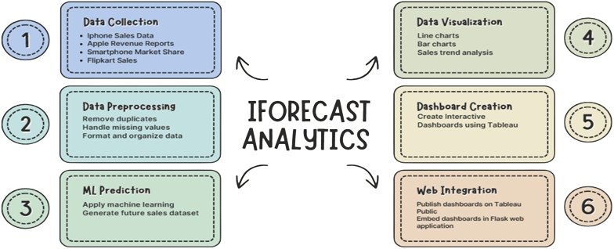
TECHNICAL ARCHITECTURE

Slide 6
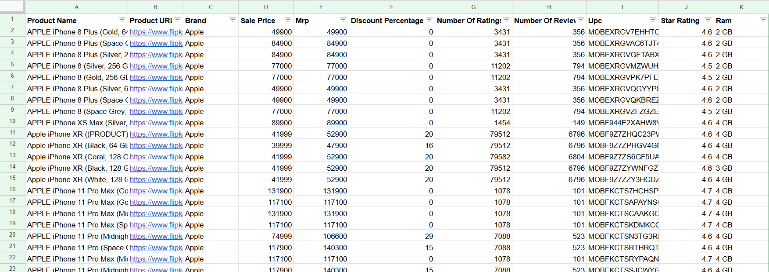
DESIGN & IMPLEMENTATION
Dataset Description
The dataset contains historical iPhone sales data, revenue statistics, and smartphone market share information in India. This data is used to train forecasting models and analyze sales trends across different time periods.

Slide 7
System Design
Data collection from multiple sources such as Flipkart, Apple reports, and market datasets.
Data preprocessing including cleaning, transformation, and formatting.
Application of time-series forecasting models to analyze sales trends.
Integration of processed data into visualization tools.

Slide 8
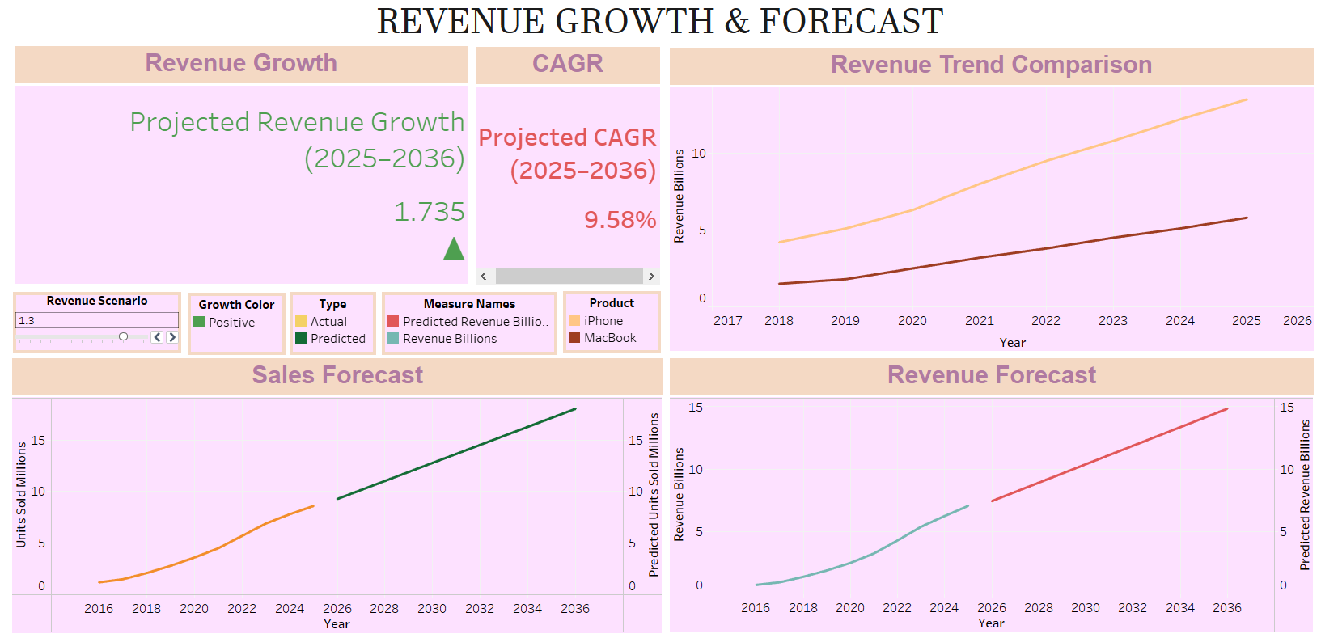
Dashboard Implementation
Interactive dashboards developed using Tableau.
Visualization of sales trends, growth patterns, and market share.
Filters and controls allow users to explore data by year, model, and region.
Forecast results are displayed through charts and graphs for better understanding.

Slide 9
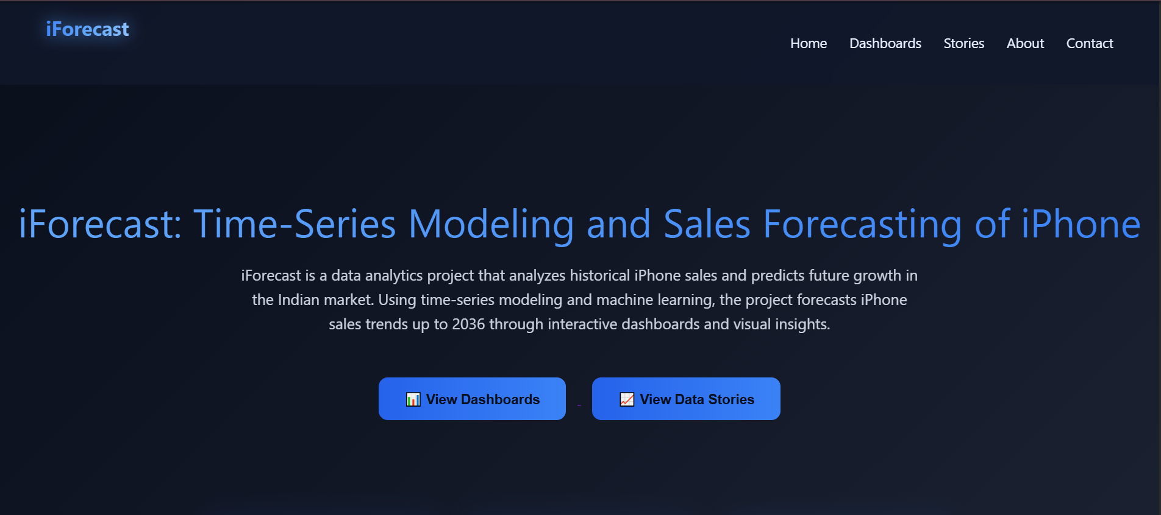
Web Integration
A web application is developed using the Flask framework
The application acts as a central platform to access all analytics dashboards
Tableau Public dashboards are embedded into the web interface
Users can interact with dashboards directly through the web application.

Slide 10
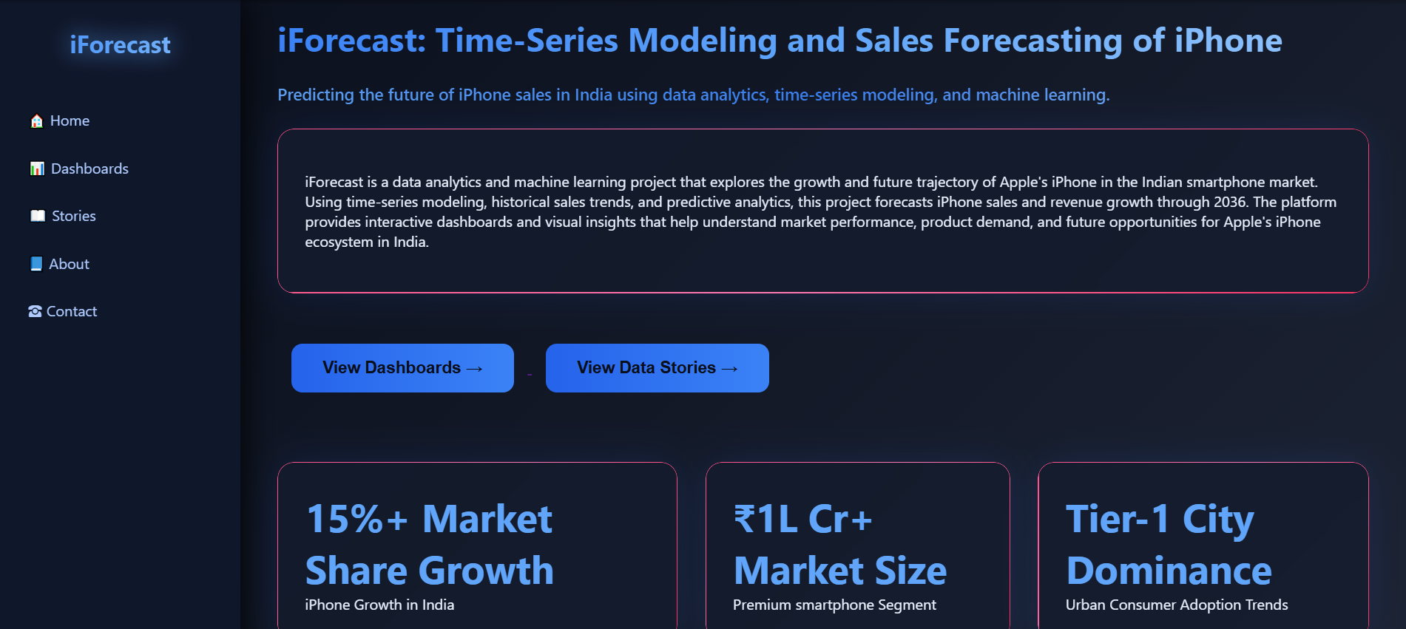
Dashboard Integration
All dashboards and stories are published on Tableau Public.
Embedded Tableau links are integrated into the Flask web application.
This allows users to view interactive dashboards without opening Tableau separately.
The integration improves accessibility and provides a unified analytics platform.

Slide 11
ADVANTAGES
Sales Forecasting - Predicts future smartphone sales trends using machine learning techniques.
Data Visualization - Interactive dashboards make complex data easier to understand.
Business Insights - Provides useful insights for marketing and sales strategy planning.
Web Accessibility - All dashboards are integrated into a single web application for easy access.
Real-Time Analysis - Enables quick analysis of historical and predicted sales trends.
Scalable Solution - The system can be extended to forecast sales for other products.

Slide 12
CONCLUSION
iForecast is a time-series based system developed to predict future iPhone sales using historical sales data and market trends.
The project applies forecasting models such as ARIMA and SARIMA to analyze seasonal patterns, trends, and demand variations in the smartphone market.
The system processes collected data through data cleaning, preprocessing, and modeling to generate accurate sales predictions.
The predicted results help companies in inventory planning, production management, and market strategy decisions, enabling better business planning.

Slide 13
THANK YOU

